Slide 1
Comp 4350 Software Engineering II Lecture 3
Dr. Shaowei Wang

Slide 2
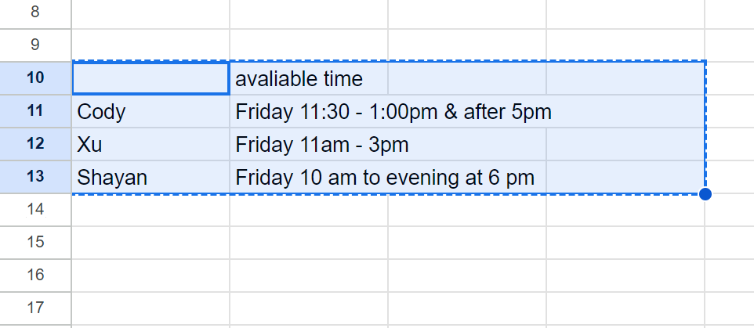
TA available time

Slide 3
Review
Version control
Code
Dependency
Configuration
Environment
Code style
Convention

Slide 4
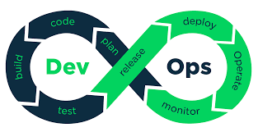
DevOps overview

Slide 5
Agenda
Why DevOps?
What is DevOps?
DevOps Stage
DevOps tools

Slide 6



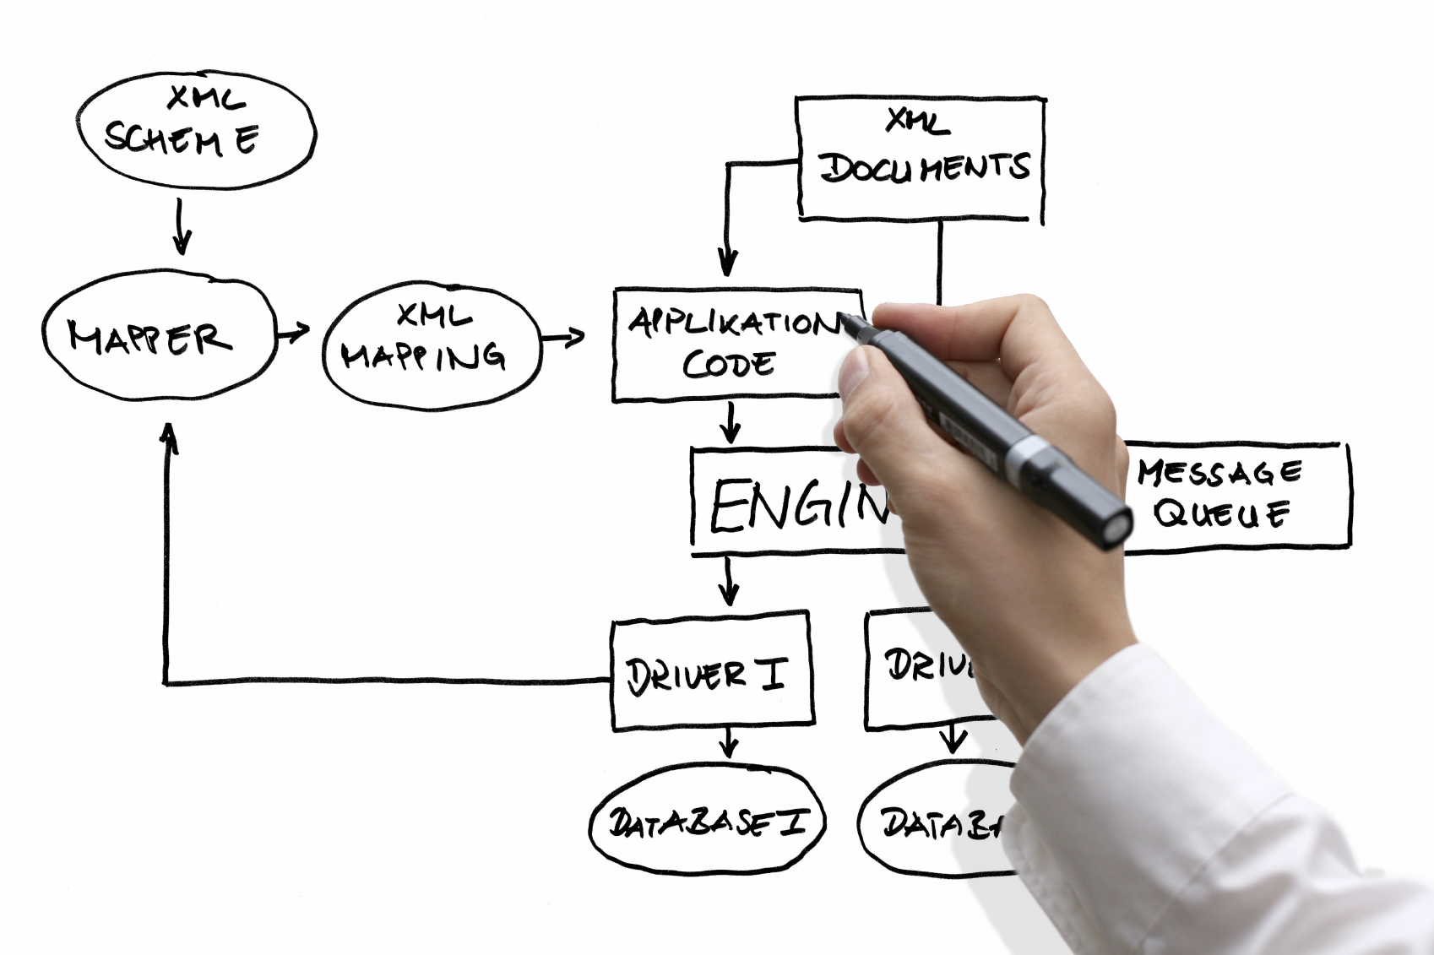
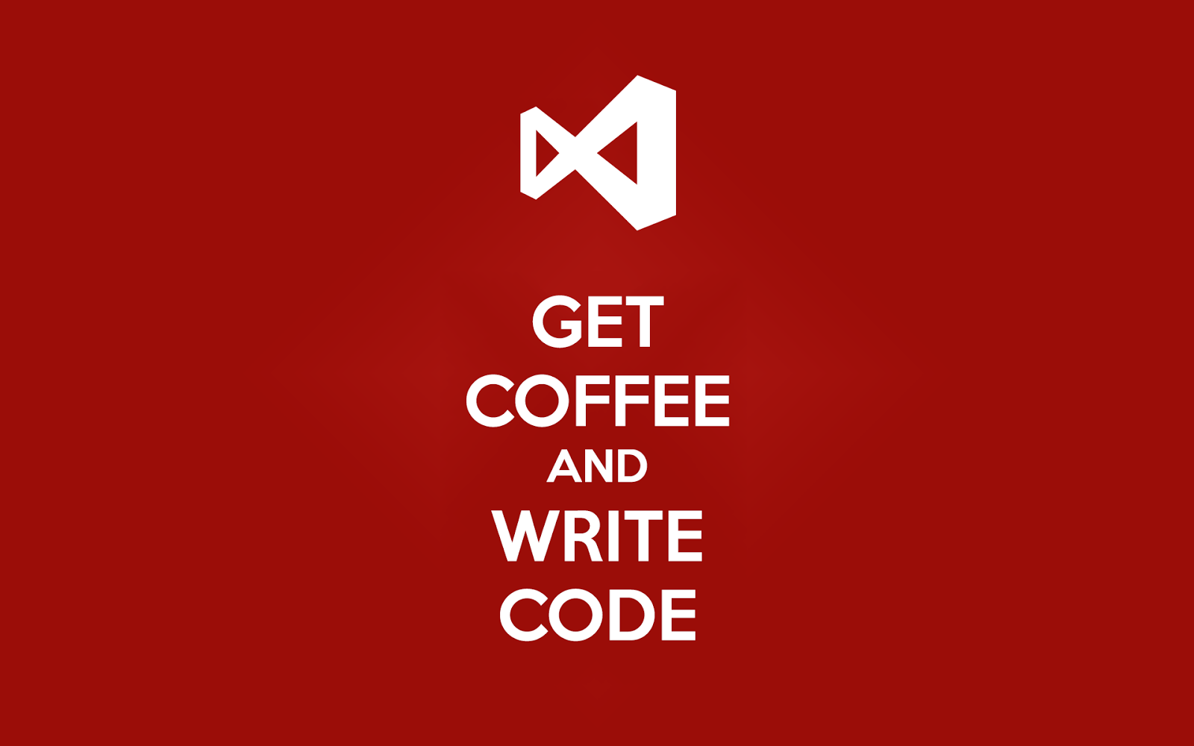


Software Development
Design and specification
Coding
Building
Testing

Slide 7





Software Operation
Deployment
Operation

Slide 8
Software Operations
Definition: The people and management processes associated with IT service management to deliver the right set of services at the right quality and at competitive costs for customers
Duties:
- Manage hardware
Deploy into production environment
Monitor the execution of production (e.g., error, performance)

Slide 9
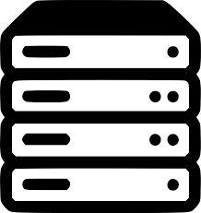

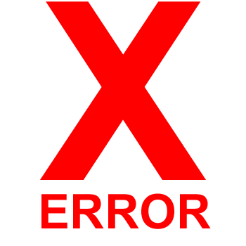

Operators
Notes:
It’s expensive to deploy all manually. And monitoring them is also a big issue.

Slide 10
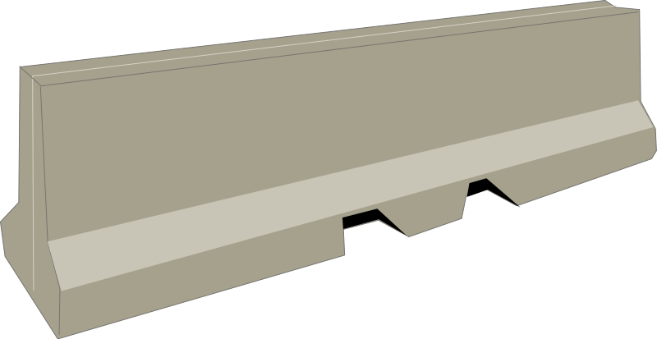
There is a gap between software developers and operators
Does my system perform well in the field?
Developers
What does this error message mean? It doesn’t work in the production.
How do I resolve it?
Operators

Slide 11
What problem is DevOps trying to solve?
Poor communication between Dev and Ops
Developers have more insights on operations
Operators have more insights on the developers
Slow product delivery
Devs want to push new features
Ops want to keep the system available/stable
→Leads to slower release schedules

Slide 12
DevOps
Remove the gap between Dev team and Ops team
Developers
Operators
Notes:
Involve developers into the operation

Slide 13
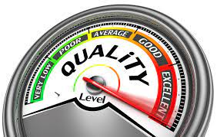
What is DevOps?
DevOps is the practice of operations and development engineers participating together in the entire service lifecycle, from design through the development process to production support, to increase organization’s ability to deliver products faster.
Goal of DevOps:
- remove the gap between operation and development
- reduce the time between committing a change to a system and the change being deployed into production environment, while ensuring high quality.

Slide 14
What does high quality mean?
High quality code
Well tested
High quality builds and delivery mechanism
Automation & more testing
No interruption of the existing system
A must when deploying to production 25x per day (etsy.com)

Slide 15
Why companies care?
IBM
“IBM has gone from spending about 58% of its development resources on innovation to about 80%” -> spend more efforts on develop new features
Paddy Power (Ireland):
“The cycle time from a user story's conception to production has decreased from several months to 2 to 5 days.
“Previously, approximately 30% of the workforce was fixing bugs. Now, bugs are so rare that the teams no longer need a bug-tracking system.” -> Auto-testing
Notes:
IBM: By removing manual process
Paddy Power is an Irish bookmaker

Slide 16
Nowadays, a profound shift is taking place and make DevOps happen
Instead of managing their own data centers, many companies are moving to the cloud, taking advantage of services such as Amazon Web Services, Azure, and Google Cloud.
Instead of investing heavily in hardware, many Ops teams are spending all their time working on software, using tools such as Jenkins, Puppet, and Docker for deployment and monitoring.
As a result, both Dev and Ops spend most of their time working on software, and the distinction between the two teams is blurring.
Notes:
Chef Software's DevOps automation tools enable the coded enterprise to overcome complexity with infrastructure,
Puppet is a software configuration management tool which includes its own declarative language to describe system configuration.

Slide 17
DevOps stages

Slide 18
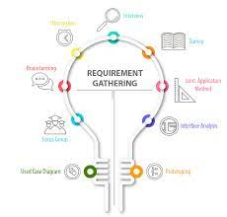
Plan
The Plan stage covers everything that happens before the developers start writing code, and it’s where a Product Manager or Project Manager earns their keep.
Requirements and feedback are gathered from stakeholders and customers and used to build a product roadmap to guide future development.
Tools:
Jira, Azure DevOps or Asana

Slide 19
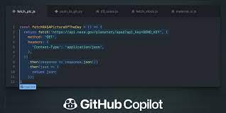
Coding
In addition to the standard toolkit of a software developer, the team has a standard set of plugins installed in their development environments to aid the development process, help enforce consistent code-styling and avoid common security flaws and code anti-patterns.

Slide 20
Build
Once a developer has finished a task, they commit their code to a shared code repository. It triggers two processes:
Automated building. An automated process which builds the codebase and runs a series of end-to-end, integration and unit tests to identify any regressions.
Code review. This manual review is supposed to be quick and lightweight, but it’s effective at identifying issues early.
Notes:
Another developer then reviews the changes they’ve made, and once they’re happy there are no issues, they approve the pull-request. This manual review is supposed to be quick and lightweight, but it’s effective at identifying issues early.

Slide 21

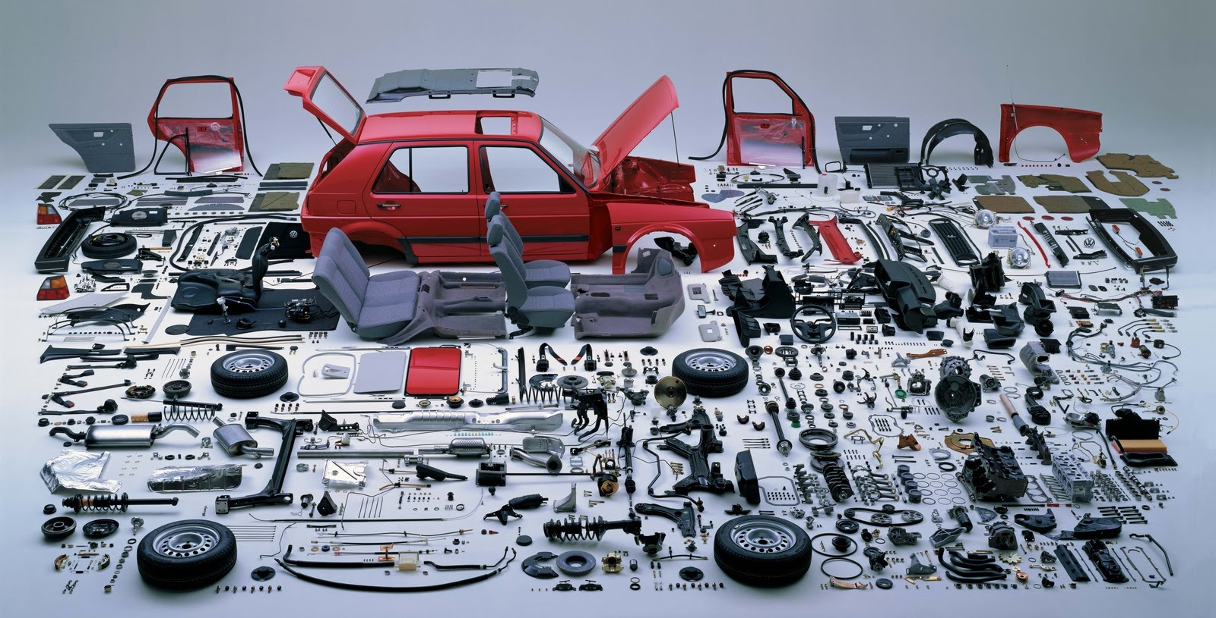








Studying the Software Development Overhead
of Build Systems
What is an automated build system?
Source code
Deliverable
21￼
Shane
McIntosh
shanemcintosh@acm.org
@shane_mcintosh
shanemcintosh.org
Modern software organizations rely on an efficient and robust build system!

Slide 22













Build systems describe how sources are
translated into deliverables
.java
.class
.jar
.java
.class
.zip
.tex
.dvi
.pdf
22￼

Slide 23
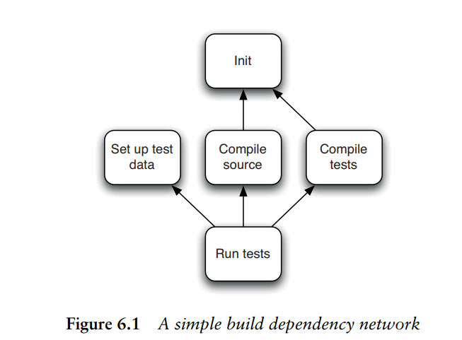
Build systems describe how sources are
translated into deliverables
When you run your tool, it will calculate how to reach the goal you specify by executing tasks in the correct order, running each task that your goal depends on exactly once.

Slide 24
Build tools
Make
A build automation tool that automatically builds executable programs and libraries from source code in Unix.
Ant
A Java library used for automating build processes for Java applications as a replacement for the Make build tool of Unix. The main benefit of Ant is its flexibility.
XML format
Maven
A build automation tool used primarily for Java projects. Maven can be considered a plugin execution framework, since all work is done by plugins.
XML format
Gradle
A build automation tool that was built upon the concepts of Ant and Maven.
Written in Groovy or Kotlin
Notes:
Another developer then reviews the changes they’ve made, and once they’re happy there are no issues, they approve the pull-request. This manual review is supposed to be quick and lightweight, but it’s effective at identifying issues early.

Slide 25
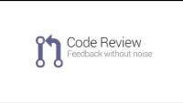
Code review

Slide 26
Testing
Once a build succeeds, it is automatically deployed to a test environment (existing hosting service) for deeper, out-of-band testing.
Manual test
traditional User Acceptance Testing (UAT) where people use the application as the customer would to highlight any issues or refinements that should be addressed before deploying into production.
Automated tests
Different levels of functional testing
security scanning against the application
performance test
load testing

Slide 27

How deep the test should be?
Notes:
Trade off between quality and cost

Slide 28

Where is the first place DevOps kicks in?

Slide 29
Continuous integration
Continuous integration (CI) is DevOps practice of integrating new code written by developers with a mainline or “master” branch frequently throughout the day, rather than having developers working on independent feature branches for weeks or months at a time, merging their code back to the master branch only when it is completely finished.
Why: Long periods of time in between merges means that much more has been changed, increasing the likelihood of some of those changes being breaking existing ones, e.g., causing conflict, break existing features.
Notes:
Why we say auto build is the first phase DevlOps kniks in. Here we come out with a concept called CI

Slide 30


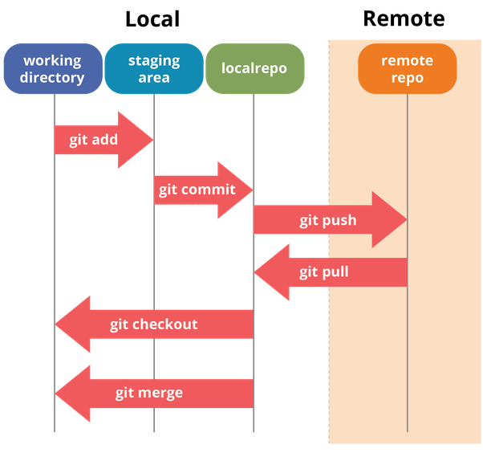

https://itnext.io/git-concepts-for-newcomers-part-2-git-repository-working-tree-and-staging-area-a2e720bf3528
Notes:
Version control enables the DevOps

Slide 31
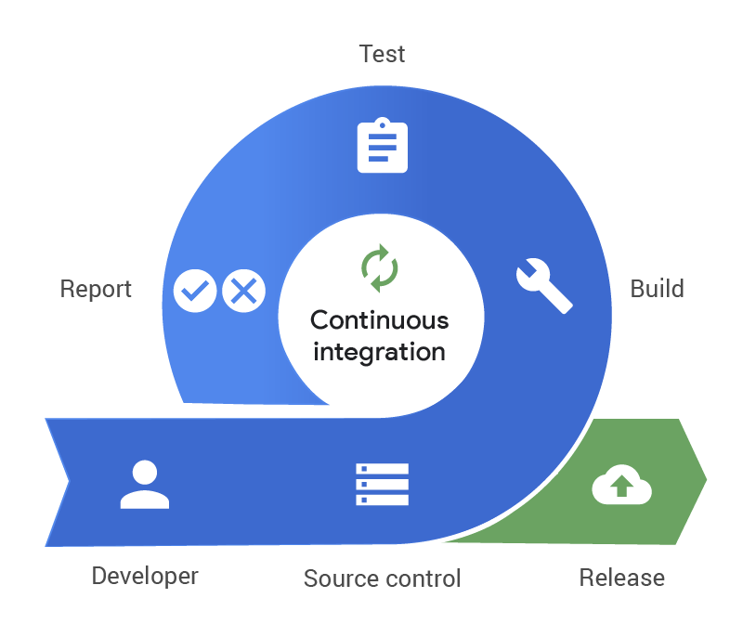
Continuous integration

Slide 32
Release
Release phase is a milestone in a DevOps pipeline - it’s the point at which we say a build is ready for deployment into the production environment.
Operations team can be confident that breaking issues and regressions are unlikely.

Slide 33
Deploy
Finally, a build is ready for the big time and it is released into production. Now it’s time to run an application on a server or device.

Slide 34
Cloud service
Organizations tend moving their deployment from on-premises IT infrastructure to cloud service
Cloud service providers
Amazon Web Services (AWS)
Google Cloud Platform
Microsoft Azure
Infrastructure-as-a-Service (IaaS)
Platform-as-a-Service (PaaS)
Software-as-a-Service (SaaS)
Different flexibility

Slide 35
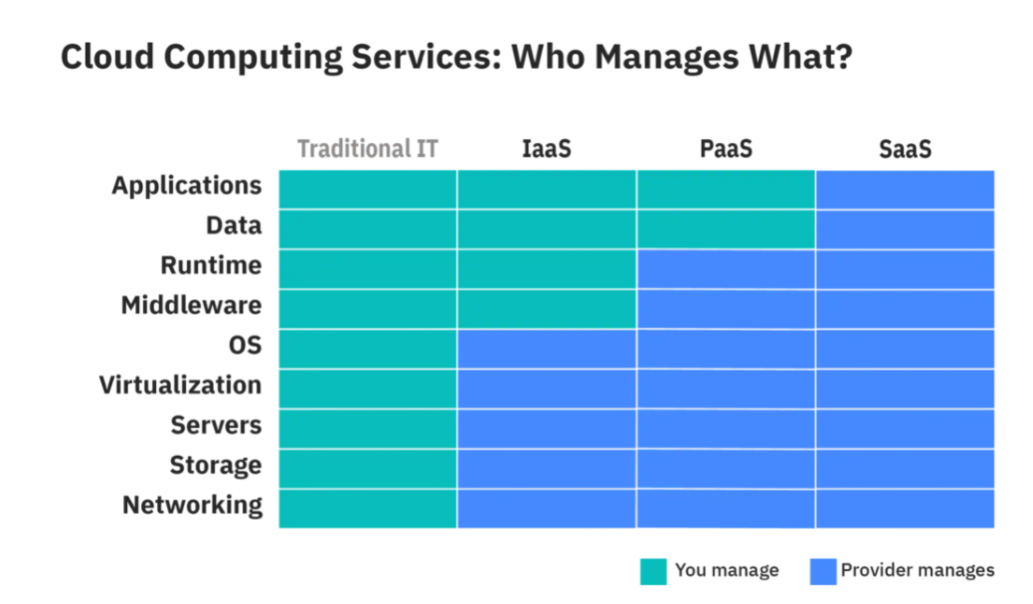
Notes:
middleware (e.g. Java runtime, .NET runtime, integration, etc.), database

Slide 36
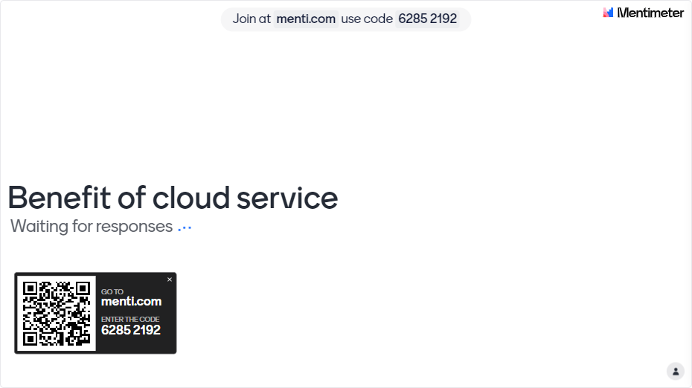
Benefit of cloud service

Slide 37
Benefit of cloud service
Scalability
you can quickly scale up or down with a few clicks
perfect solution for handling peak loads
Cost-effectiveness
removes hardware expenses
no need to buy, install, configure, and maintain servers, databases, and other components of your runtime environment
What only for what you use
Immediate availability
Cloud solutions are available as soon as you’ve paid for them
Notes:
Scalability. On-premises solutions are rather difficult to scale, as the type of hardware needed depends on your application’s demands. If your app experiences heavy traffic, you might need to significantly upgrade on-premises hardware. This problem doesn’t exist with a cloud service, which you can quickly scale up or down with a few clicks. Cloud services are a perfect solution for handling peak loads. With cloud-based services, businesses can use whatever computing resources they need.
Cost-effectiveness. Cloud computing removes hardware expenses, as hardware is provided by a vendor. There’s no need to buy, install, configure, and maintain servers, databases, and other components of your runtime environment. Moreover, using cloud-based solutions, you pay only for what you use, so if you don’t need extra resources you can simply scale down and not pay for them.
Immediate availability. Cloud solutions are available as soon as you’ve paid for them, so you can start using a cloud service right away. There’s no need to install and configure hardware.
Performance. Cloud companies equip their data centers with high-performance computing infrastructure that guarantees low network latency for your applications.
Security. Cloud infrastructure is kept in safe data centers to ensure a top level of security. Data is backed up and can easily be recovered. Moreover, cloud vendors ensure the security of your data by using networking firewalls, encryption, and sophisticated tools for detecting cybercrime and fraud.

Slide 38
Benefit of cloud service
Performance
equip their data centers with high-performance computing infrastructure that guarantees low network latency for your applications.
Security
kept in safe data centers to ensure a top level of security
data is backed up and can easily be recovered.
Notes:
Scalability. On-premises solutions are rather difficult to scale, as the type of hardware needed depends on your application’s demands. If your app experiences heavy traffic, you might need to significantly upgrade on-premises hardware. This problem doesn’t exist with a cloud service, which you can quickly scale up or down with a few clicks. Cloud services are a perfect solution for handling peak loads. With cloud-based services, businesses can use whatever computing resources they need.
Cost-effectiveness. Cloud computing removes hardware expenses, as hardware is provided by a vendor. There’s no need to buy, install, configure, and maintain servers, databases, and other components of your runtime environment. Moreover, using cloud-based solutions, you pay only for what you use, so if you don’t need extra resources you can simply scale down and not pay for them.
Immediate availability. Cloud solutions are available as soon as you’ve paid for them, so you can start using a cloud service right away. There’s no need to install and configure hardware.
Performance. Cloud companies equip their data centers with high-performance computing infrastructure that guarantees low network latency for your applications.
Security. Cloud infrastructure is kept in safe data centers to ensure a top level of security. Data is backed up and can easily be recovered. Moreover, cloud vendors ensure the security of your data by using networking firewalls, encryption, and sophisticated tools for detecting cybercrime and fraud.

Slide 39
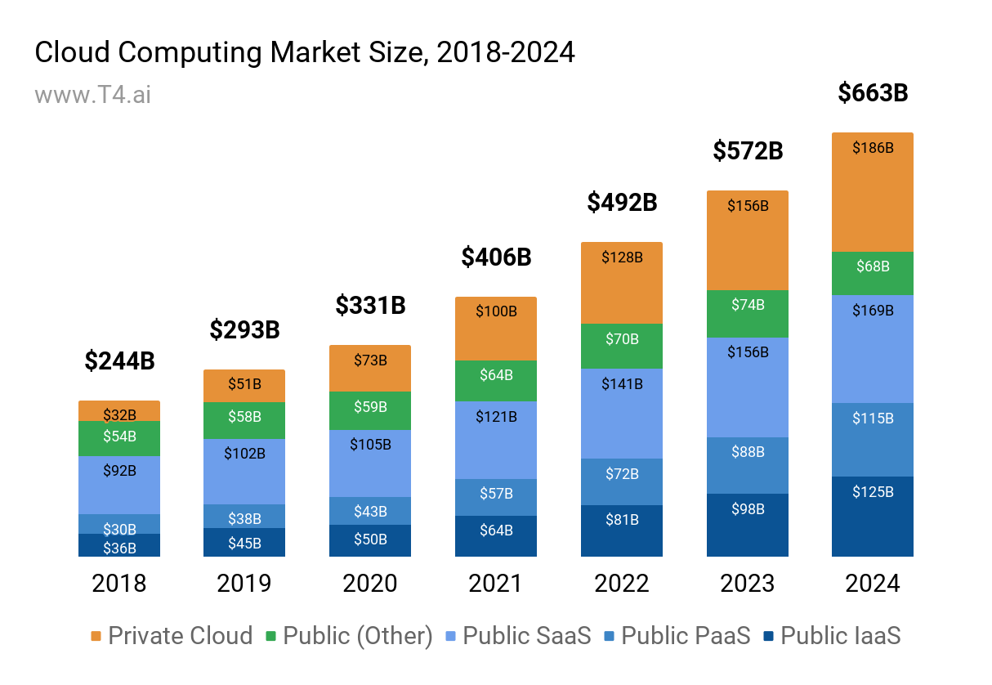
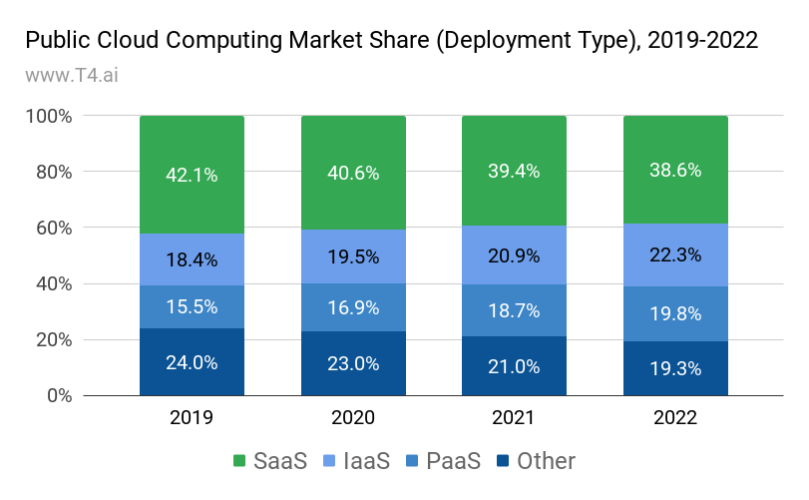
Cloud Business Process Services, Cloud Management and Security Services, and Desktop as a Service
https://www.t4.ai/industry/cloud-computing-market-share
Notes:
Public Cloud - a public cloud is a solution when a cloud vendor supplies clients with access to their data center infrastructure. The vendor is responsible for maintenance, management, security and various upgrades. Private Cloud - a private cloud is a solution when clients host their own data center. The responsibility for managing, updating, and securing the infrastructure is on the client side, which might include hiring third parties for these purposes. IaaS (Infrastructure as a Service) - this is a cloud computing offering where the vendor provides the client with on-demand access to resources such as networking, storage, and servers. The client runs their own applications and platforms within the infrastructure. PaaS (Platform as a Service) - this is a cloud computing offering where the vendor provides the client with access to a cloud environment for developing, managing, and hosting applications. SaaS (Software as a Service) - this is a cloud computing offering where the vendor provides the client with access to cloud-based software.
other categories - Cloud Business Process Services, Cloud Management and Security Services, and Desktop as a Service

Slide 40
Continuous Delivery
Continuous Delivery is an extension of CI since it enables automation to deploy all the code changes to an environment (dev, qa, prod) after the changes have been merged.
Developers can deploy their changes at any time by simply clicking a button or at the completion of CI.

Slide 41
Continuous Deployment
Continuous Deployment takes the process one step further than continuous delivery.
All changes that pass the verification steps at each stage in the pipeline are released to production. This process is completely automated and only a failed verification step will prevent pushing the changes to production.

Slide 42
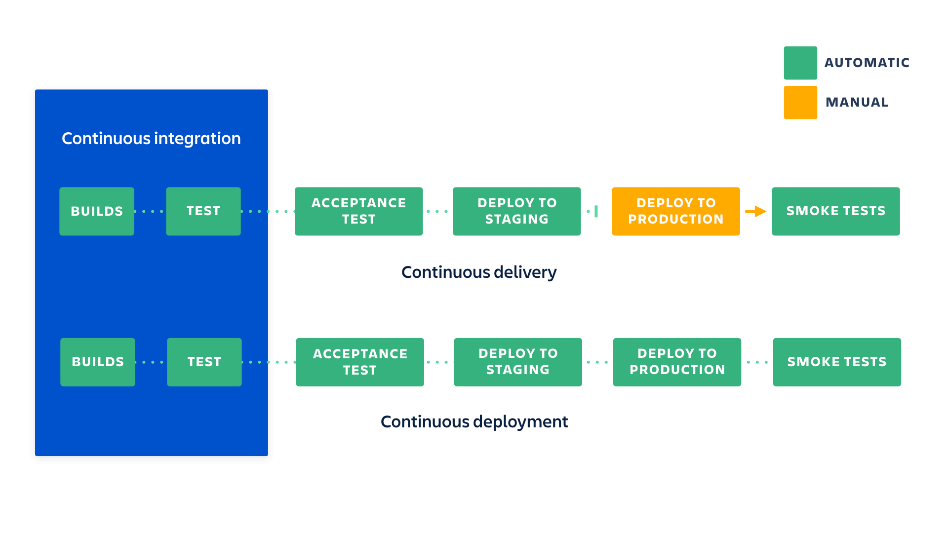

Slide 43
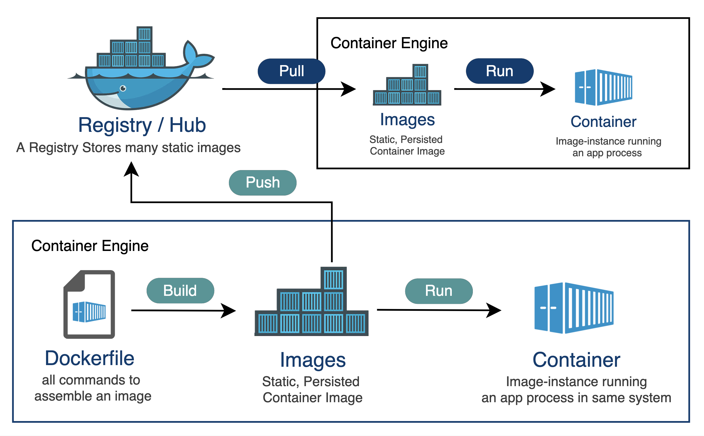
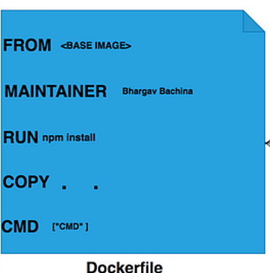
CD using docker

Slide 44
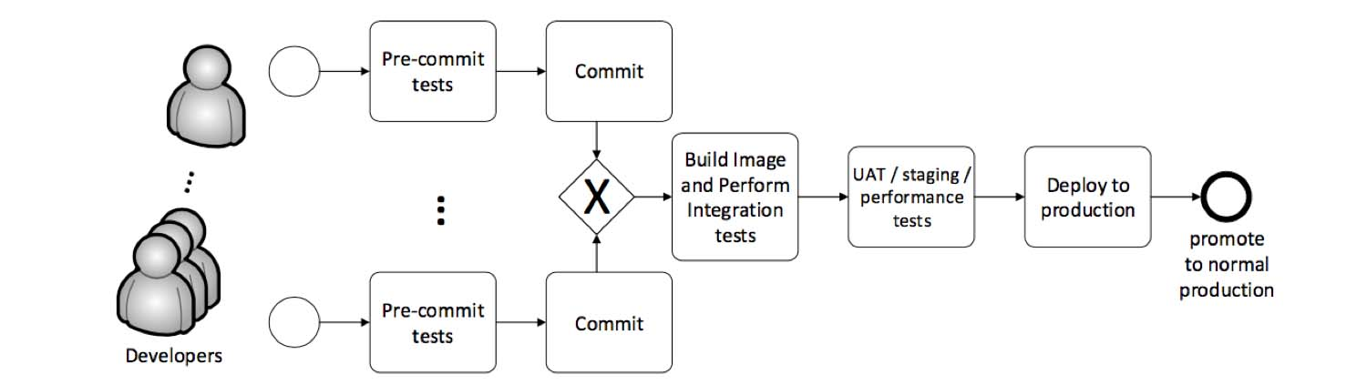
Continuous Delivery Pipeline
Notes:
UAT : user acceptance test

Slide 45
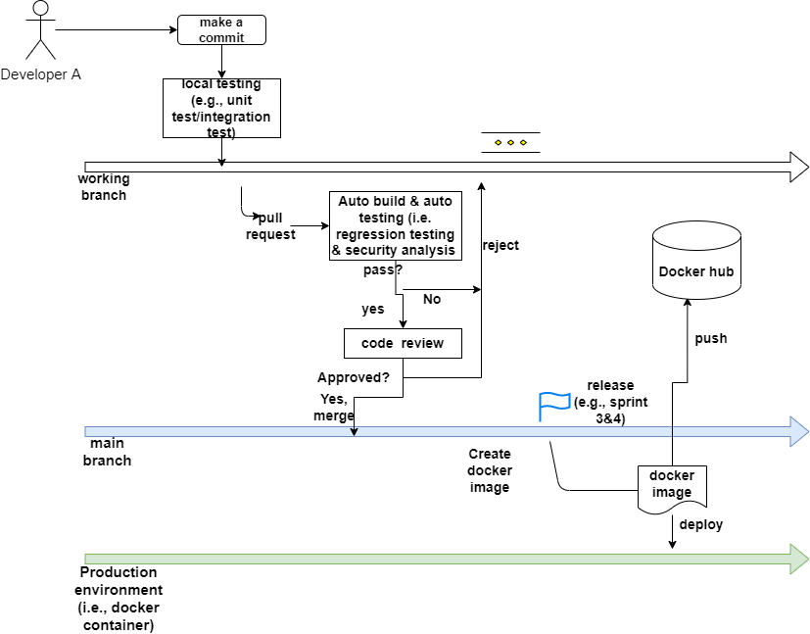
Continuous delivery pipeline

Slide 46
Development strategy - blue/green deployment
A deployment strategy to reduces downtime and risk by running two identical production environments called Blue (old environment) and Green (new environment).
When the new environment is ready, the hosting service (e.g., Nginx) points all new requests to the new environment. If at any point, an issue is found with the new build, you can simply tell the hosting service to point requests back to the old environment while you come up with a fix.

Slide 47
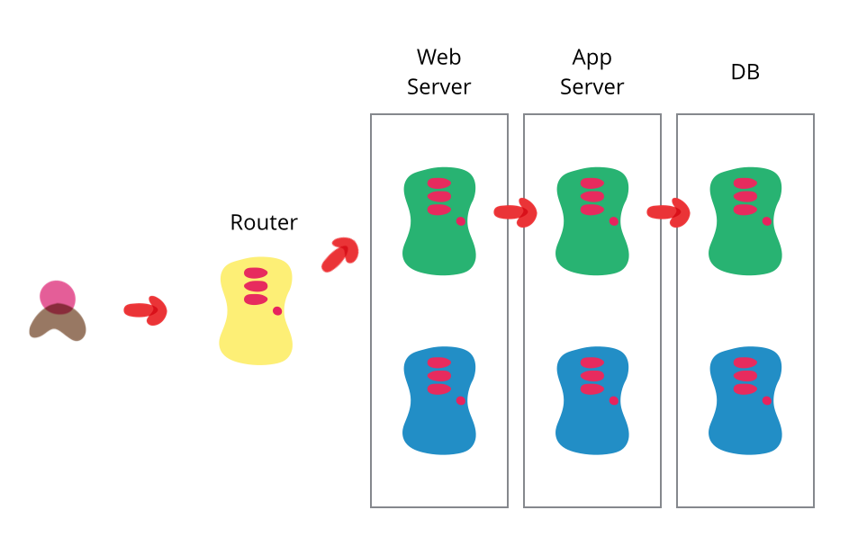

Slide 48


Slide 49
Operate
Based on the configuration of the hosting service, the environment automatically scales with load to handle peaks and troughs in the number of active users.
The organisation has also built a way for their customers to provide feedback on their service, as well as tooling that helps collect and triage this feedback to help shape the future development of the product.

Slide 50
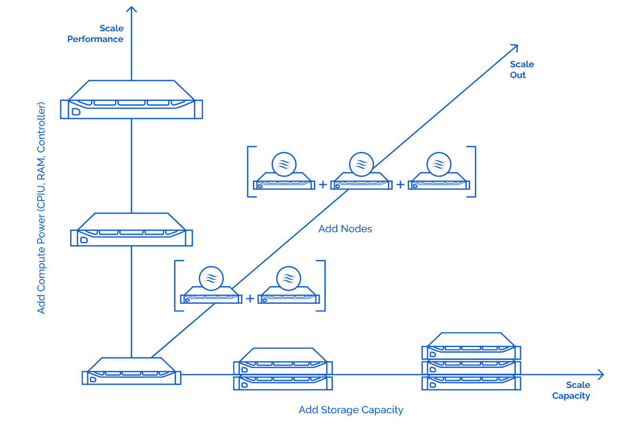
Operate
Based on the configuration of the hosting service (AWS), the environment automatically scales with load to handle peaks and troughs in the number of active users.

Slide 51
Monitor
The ‘final’ phase of the DevOps cycle is to monitor the environment.
It is a process to monitor and identify compliance issues and security risks throughout each phase of DevOps lifecycles.
It helps organizations to track, identify, understand key metrics and also resolve application or infrastructure issues in real-times.

Slide 52
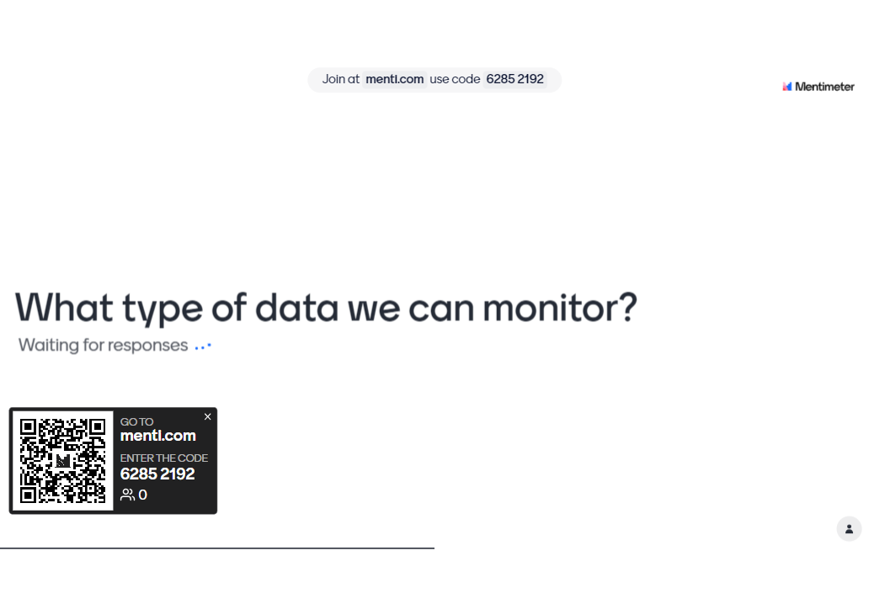
What type of data we can monitor?

Slide 53

Monitoring data type
code
deploy
plan
Logs
Metrics
Traces
Alerts
Dev
release
Ops
build
operate
test
monitor
Notes:
Through monitoring, DevOps engineers collect data such as logs, metrics, traces, and alerts.
Software monitoring produces large volumes of monitoring data, including logs, metrics, and traces.
By capturing and analyzing the monitoring data, engineers understand how changes or updates impact users, obtain clues about the root causes of runtime problems, and find evidences of unexpected runtime behaviors.
https://aws.amazon.com/devops/what-is-devops/
Active monitoring becomes increasingly important as software release cycles become shorter. For example, Facebook is released every few hours.
Under a sh

Slide 54
Types of monitoring
Infrastructure Monitoring
to collect and analyze data from the IT infrastructure and leverage that data to improve the final results.
Application Monitoring
offers runtime metrics of system performance like application uptime, application-performance, application security-monitoring, log-monitoring etc
Network Monitoring
monitor and track everything about the network, like routers, firewalls, servers, switches, and VMs.

Slide 55
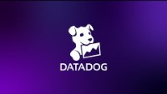
Notes:
https://www.youtube.com/watch?v=nqR8-ASHtVk

Slide 56
DevOps Practices
Automate Everything.
CI: automatic build, testing
CD: automatic deployment
Develop infrastructure code with the same set of practices as application code
We need “infrastructure as Code” : using IaaS APIs, etc., to automate creation of environments (Docker)
Misconfiguration can derail your application (Puppet)
Notes:
Puppet
docker

Slide 57





Slide 58
Reference
Chapter 2 & 4 & 6, Effective DevOps, Jennifer Davis & Katherine Daniels
https://rubygarage.org/blog/iaas-vs-paas-vs-saas
https://www.indellient.com/blog/whats-the-difference-between-continuous-integration-continuous-delivery-and-continuous-deployment/

Slide 59
DevOps Consequences
Keep teams relatively small
Amazon’s “two pizza rule”: you should be able to feed the team with two pizzas
Advantages: make decisions quickly, less coordination overhead, more coherent units
Notes:
discourage creative thinking
create a decentralized and innovative workplace environment
Make things faster
http://whatis.techtarget.com/definition/two-pizza-rule

Slide 60
DevOps Consequences
Team size becomes a major driver of the overall architecture:
Small teams develop small services -> Microservices
Coordination overhead is minimized by channeling most interaction through service interfaces:
Team X provides service A, which is used by teams Y and Z
If changes are needed, they are communicated, implemented, and added to the interface.
Notes:
From Wikipedia: It also parallelizes development by enabling small autonomous teams to develop, deploy and scale their respective services independently

Slide 61
Try it out using TravisCI
Set up TravisCI for:
Fork this repository:
https://github.com/shaoweiwang2010/TravisExercise
Go to https://travis-ci.org/ and log in with your github account
In your profile page, enable Travis’s access to the repo of TravisExercise
On your machine clone your repository
git clone REPLACE_THIS_BY_YOUR_REPO_URL
Add a .travis.yml file to your forked repository
specify the language by putting: language: java
Push a change to break the build (in your forked repo) and see if Travis finds it!
You need to show your CI works and have empty tests available in the Sprint 2!
Notes:
https://docs.travis-ci.com/user/tutorial/

Slide 62
We need automation and tool supports!

Slide 63
Try it out using TravisCI
Read about how to set up Travis CI for your fork here:
https://travis-ci.org/
http://docs.travis-ci.com/user/getting-started/
http://docs.travis-ci.com/user/languages/java/
http://docs.travis-ci.com/user/languages/java/#Projects-Using-Ant
http://docs.travis-ci.com/user/customizing-the-build/
Add a .travis.yml file to your forked repository
Push a build break into your fork to see if Travis finds it!
BONUS: Make your repository based on Maven and use Travis to build and test!

Slide 64

Process 1: Waterfall
Requirements definition
System and software design
Implementation and unit testing
Integration and system testing
Operations and maintenance
Notes:
organizations were using this particular software development methodology. It was first documented in the year 1970 by Royce and was the first public documented life cycle model. The waterfall model describes a development method that is linear and sequential waterfall development has distinct goals for each phase of development. Now, you must be thinking why the name waterfall model because it's pretty similar to a waterfall. Now what happens in a waterfall once the water has flowed over the edge of the cliff. It cannot turn back the same is the case for waterfall development strategy as well. An application will go to the next stage only when the previous stage is complete.

Slide 65
Limitations of waterfall
No working software is produced until late during the life cycle
Once an application is in the testing stage, it is difficult to get back and change something that was not well-thought out
High amounts of risk and uncertainty
Not a good model for a project where requirements are at a moderate to high risk of change

Slide 66
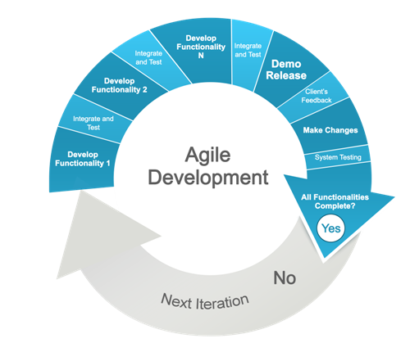
Agile development
Customer feedback
Customer feedback
Customer feedback
Customer feedback
Notes:
Cadence: sound wave etc. Things should be sustainable and continuous

Slide 67
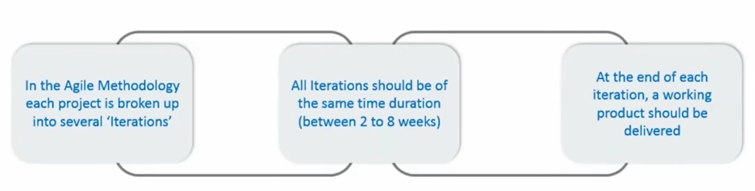
Agile development

Slide 68
https://itnext.io/git-concepts-for-newcomers-part-2-git-repository-working-tree-and-staging-area-a2e720bf3528

